Slide 1
Guess the movie!
Andrianov Andrei
Markowitsch Georg

Slide 2
What it is
Guess movies based on screenshot and randomized letters
Random movie from a pool of movies
Movie pool can be configured by user
3 lives per game, lose one live if wrong guess or skip

Slide 3
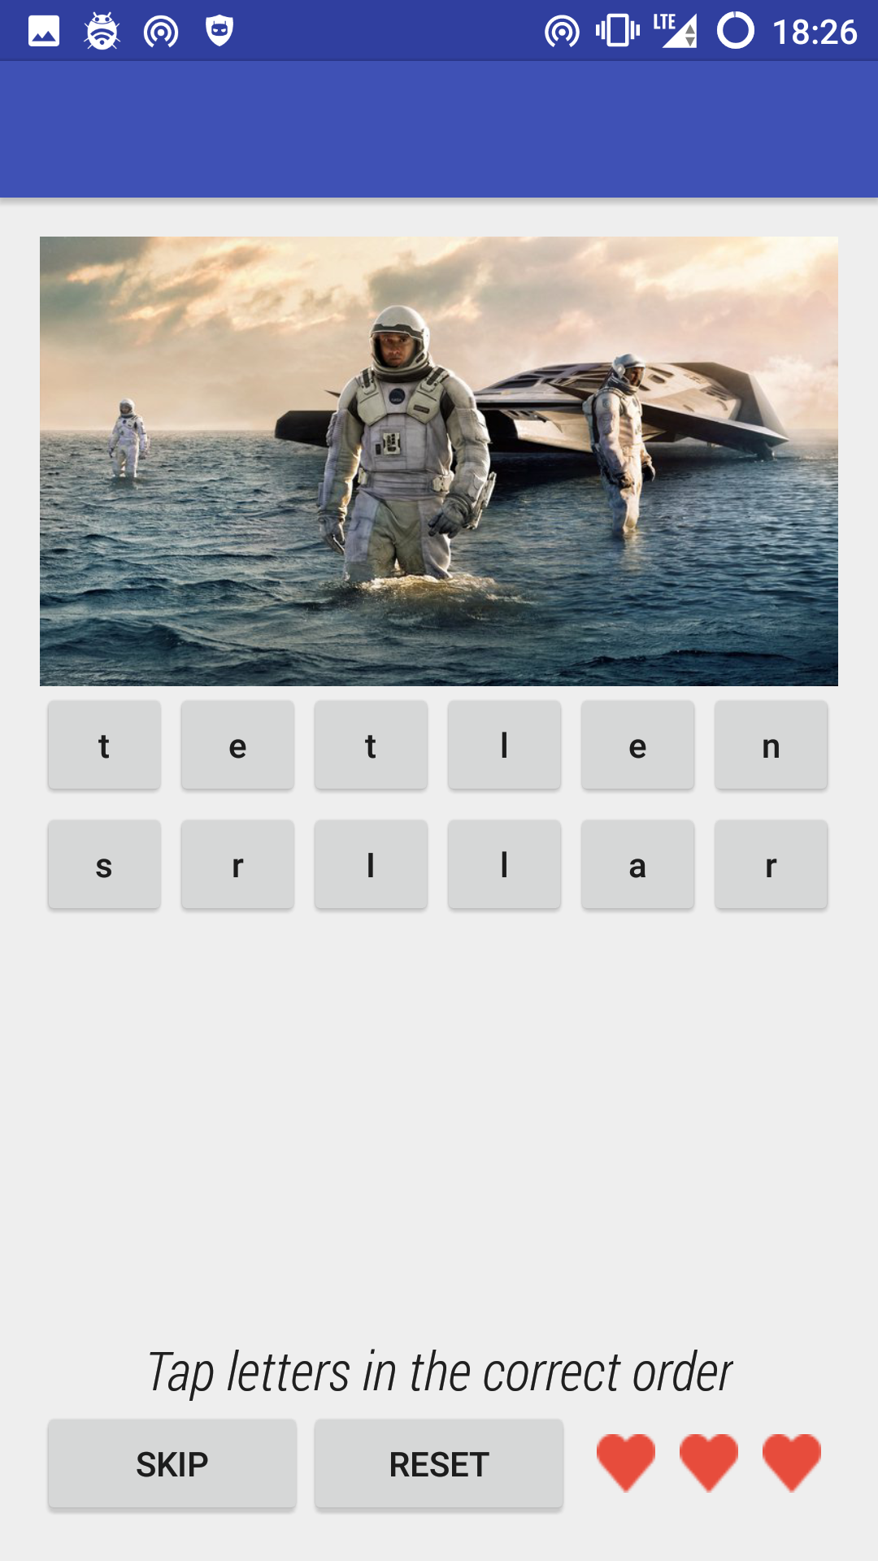
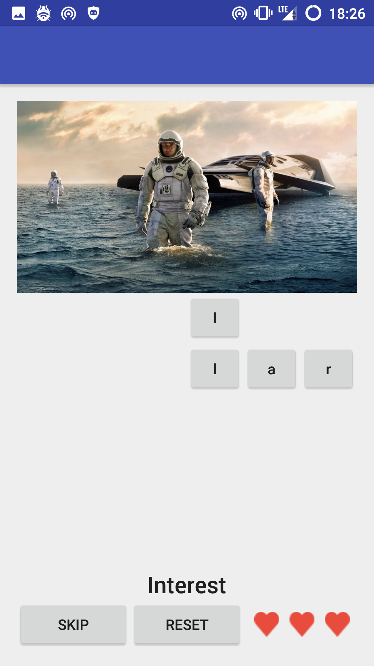
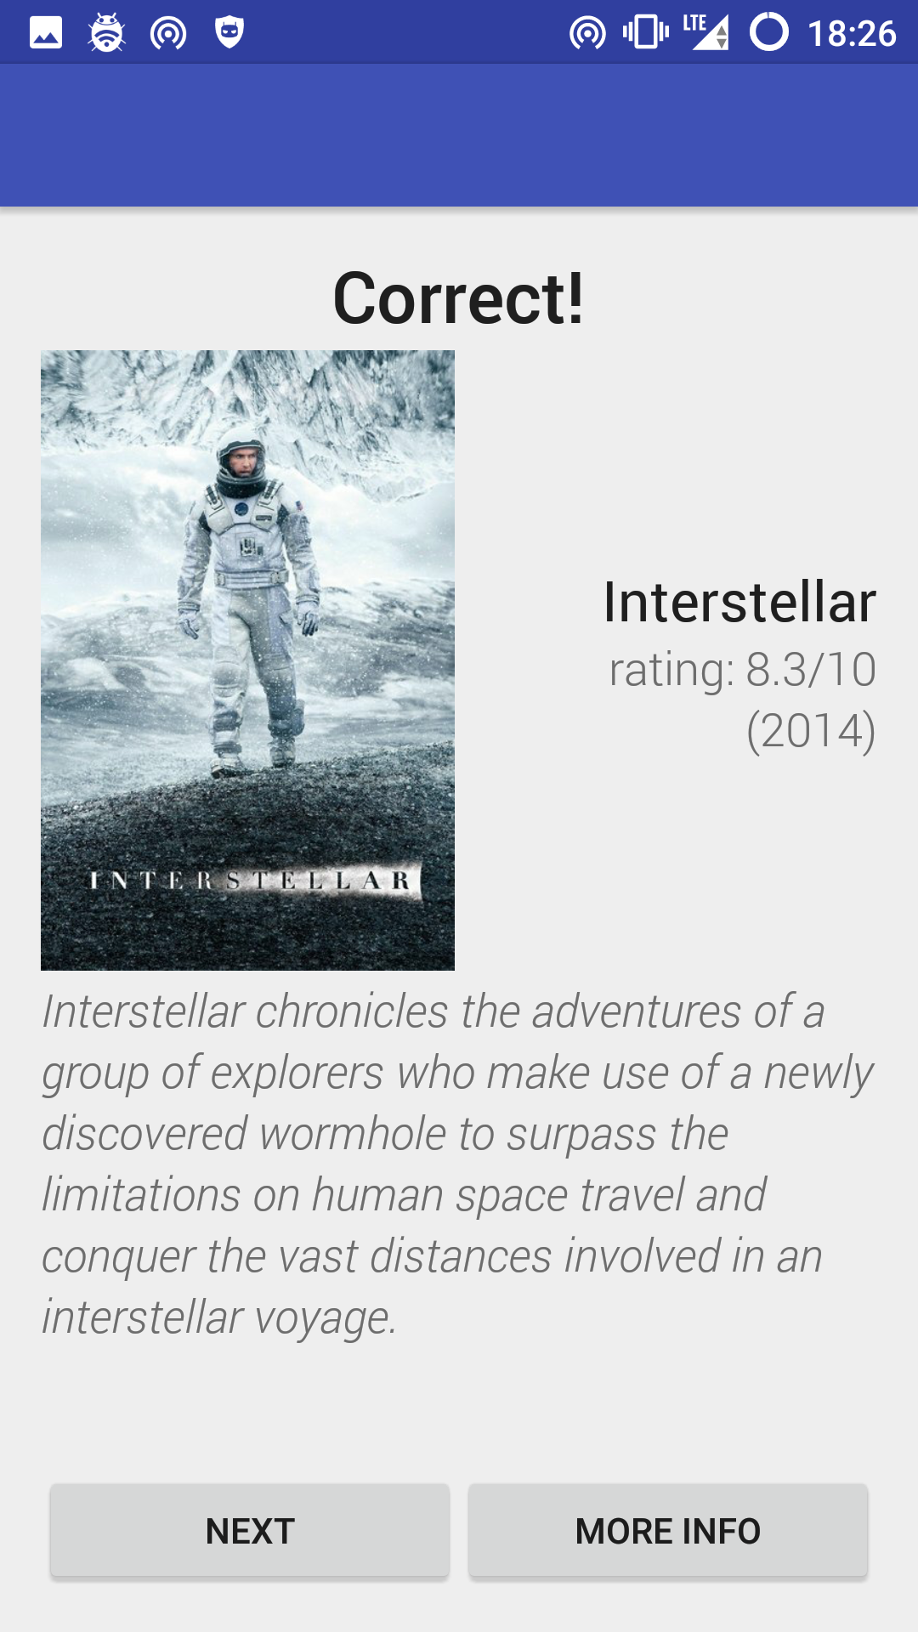
How it looks

Slide 4
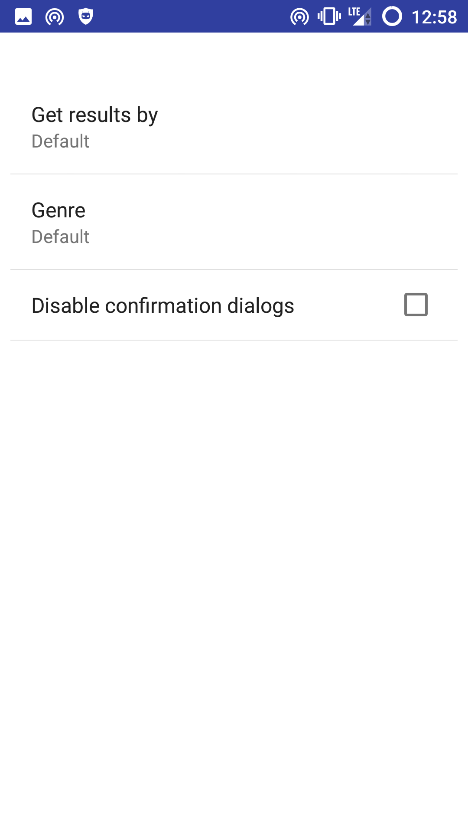
Configuration
Get results by ranking/popularity
Get only movies with a certain genre

Slide 5

The source
One of the best places to get movie data and images
Community driven and completely free
Free api to access the whole movie database

Slide 6
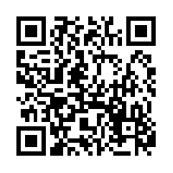
Thank you for your attention

